Slide 1
DISLOCATIONS AND FRACTURE DISLOCATIONS OF THE HIP JOINT
G.M.WERU
Lecturer clinical medicine

Slide 2
TYPES
Posterior dislocation- Accounts for 80%
Anterior dislocation
Central fracture dislocation

Slide 3
POSTERIOR DISLOCATION
MECHANISMS OF INJURY
Head on collision or any violent force against the knee with a flexed or semi flexed and adducted hip joint
Motor cycle crash

Slide 4
Cont.
CLINICAL FEATURES
Pain on the affected joint
Restricted movement of the affected joint
The leg on the affected side is shorter and the hip joint is adducted, slightly flexed and medially(internally) rotated
Head of femur can be felt posterior and superiorly to the acetabulum
Tenderness

Slide 5
Cont.
INVESTIGATION
Pelvic X-RAY(A/P)
X-ray of affected joint (lateral or oblique view at 45°)
Shows the femoral head in the postero-lateral position in relation to the acetabulum
Usually there is an associated chip fracture of the acetabular roof

Slide 6
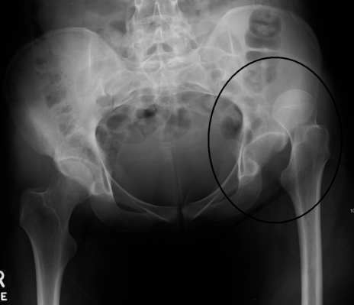
Posterior dislocation

Slide 7
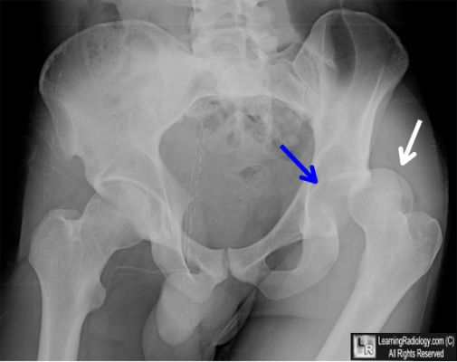
Posterior dislocation

Slide 8
Cont.
TREATMENT
Immediate closed reduction under G/A and muscle relaxant.
Technique
The patient is laid supine on the ground on a soft mattress
An assistant steadies the pelvis at the iliac crests
The surgeon/clinician flexes the hip and knee joints at 90° and pulls the thigh upwards as well as gradually externally(laterally) rotating the femur
Gently test all movements, and request for check X-rays

Slide 9
Cont.
Immobilize the limb with skin traction for 3-6 weeks. Mean while mobilizing the exercises for the hip and knee joints are begun a few days and are gradually intensified
Upon discharge, the patient continues with non-weight bearing(crutches) for 6 more weeks.
2. Open(operative) reduction if closed reduction fails especially for neglected cases.

Slide 10
Cont.
COMPLICATIONS
Injury to sciatic nerve
Damage to femoral head
Associated fracture of acetabular roof
Avascular necrosis of femoral head
Post- traumatic ossification
Osteoarthritis

Slide 11
ANTERIOR DISLOCATION
MECHANISMS OF INJURY
Road traffic accident when the force approaches from behind
When a weight falls on the back of a patient when the knee joints are straightened and bent forward
The head of femur dislocates anteriorly and inferiorly in relation to the acetabulum

Slide 12
Cont.
CLINICAL FEATURES
Pain on the affected joint
Inability to move the joint
Deformity of the limb, which the opposite of that of posterior dislocation; the leg on the affected side is longer, extended, abducted and laterally(externally) rotated
Tenderness

Slide 13
Cont.
INVESTIGATION
Pelvic X-RAY (A/P)
X-ray of affected joint (lateral views)
Femoral head is seen lying anteriorly and inferiorly to the acetabulum

Slide 14
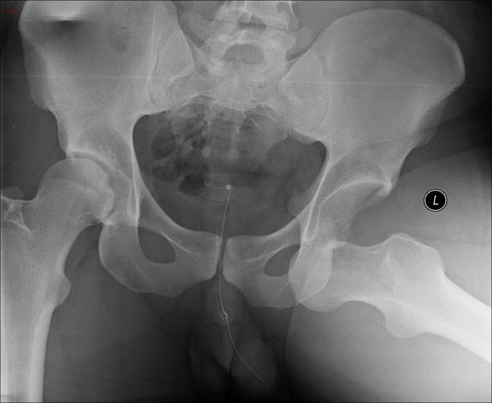
Anterior hip dislocation

Slide 15
Cont.
TREATMENT
Closed reduction under G/A and muscle relaxant.
Technique
The patient is laid supine on the ground
An assistant steadies the pelvis at iliac crests
The surgeon flexes the hip and knee joints at 90° and pushes the femur backward into the acetabulum
Test the joint movement and request for check x-rays
Immobilize the limb with skin traction for 3-6 weeks
Discharge the patient on non-weight bearing for 6 weeks

Slide 16
Cont.
2. Open(operative) reduction if closed reduction
fails.

Slide 17
Cont.
COMPLICATIONS
Compression to femoral nerve
Compression to femoral artery
Avascular necrosis of femoral head
Osteoarthritis

Slide 18
CENTRAL FRACTURE DISLOCATION
It is regarded as fracture dislocation because the femoral head smashes into the acetabular floor before going through it into the pelvis
MECHANISMS OF INJURY
A violent central force against the greater trochanter
Road traffic accident
The head of femur is driven into the acetabular floor causing a comminuted fracture of the acetabulum

Slide 19
Cont.
CLINICAL FEATURES
Some patients may present in shock if there is severe concealed bleeding
Pain
Inability to move the joint
± Bruising over the trochanteric region
The leg lies in normal position and is of normal length
Tenderness

Slide 20
Cont.
INVESTIGATIONS
Pelvic X-RAY( A/P view)
Reveals fracture of the acetabular floor
± Fracture of the femoral head
CT Scan- Reveals the extent of damage to the acetabular floor

Slide 21
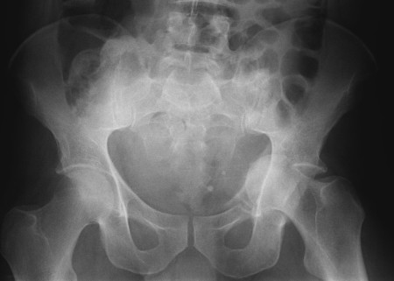
Central fracture dislocation

Slide 22
Cont.
TREATMENT
Resuscitation with fluid replacement or transfusion and surgical repair of damaged blood vessels
Closed reduction under G/A
An assistant steadies the pelvis
The surgeon pulls the thigh at the same time attempts to lever out the femoral head from its displaced position
Apply skin traction for six weeks and commence active movements afterwards
Discharge the patient on non-weight bearing for 6 weeks

Slide 23
Cont.
Open reduction with internal fixation if the acetabular fracture is severely comminuted using combination of multiple screws and contoured plates
It should be borne in mind that many patients with central dislocation will eventually need total Arthroplasty on account of secondary degenerative changes

Slide 24
Cont.
COMPLICATIONS
Damage to pelvic organs and blood vessels leading to Hypovolaemic shock
Early osteoarthritis- Which is inevitable

